Slide 2
Time | Min. | Session
10:00 – 10:05 | 5 | Welcome
10:05 – 10:30 | 25 | Session 1 - Microsoft Edge, a break from the past
10:30 – 11:15 | 45 | Session 2 - Innovations of the web
11:15 – 11:45 | 30 | Session 3 - Modern front-end tooling in Visual Studio
11:45 – 12:30 | 45 | HOL - Modern front-end tooling in Visual Studio (part 1)
12:30 – 13:30 | 60 | Lunch
13:30 – 14:00 | 30 | HOL - Modern front-end tooling in Visual Studio (part 2)
14:00 – 14:30 | 30 | Session 4 - Introduction to ASP.NET Core & Visual Studio Code
14:30 – 15:00 | 30 | HOL - Introduction to ASP.NET Core 1.0
15:00 – 15:15 | 15 | Break
15:15 – 16:00 | 45 | Session 5 - Introduction to Azure for web developers
16:00 – 16:50 | 50 | HOL - Getting started with Azure App Service Web Apps
16:50 – 17:00 | 10 | Conclusion

Slide 3
Modern front-end tooling in Visual Studio 2015
Jesse van Leth
Technical Evangelist

Slide 4
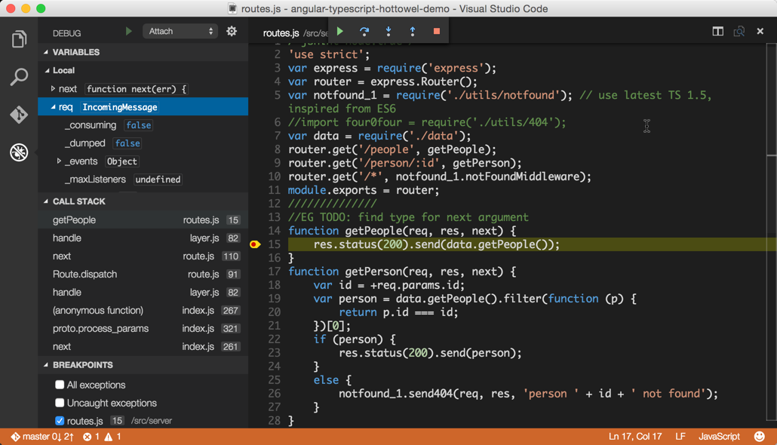
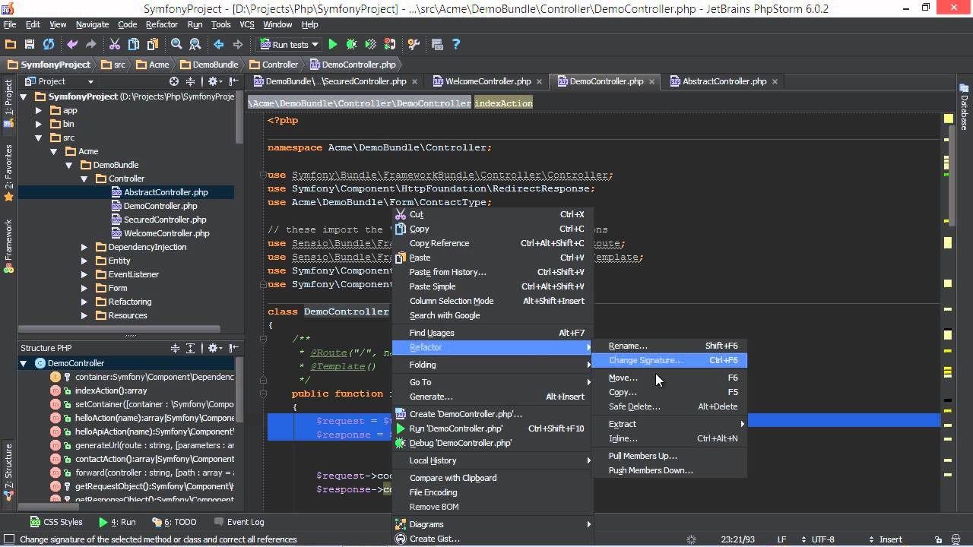
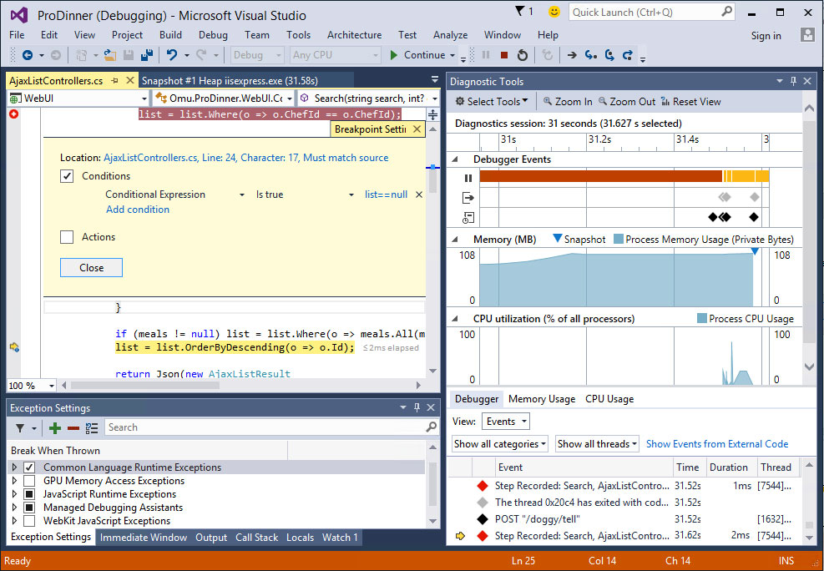
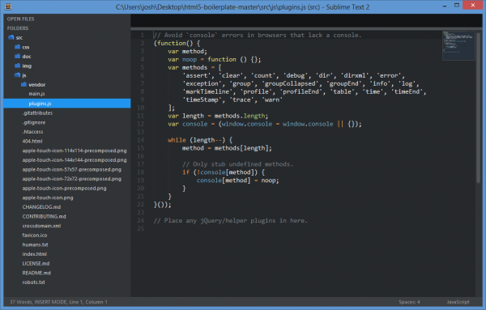
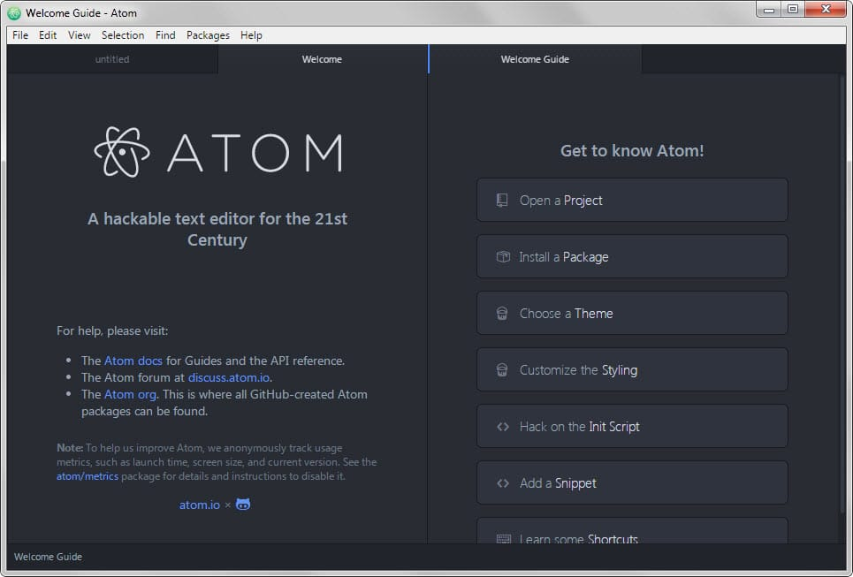
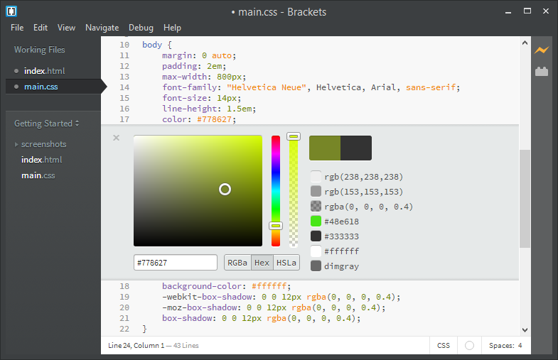

Slide 5
What Modern Web Development Tools are about
Package managers (dependency management)
New features (adoption of pre-standards)
Task runners (build systems)
Extensions

Slide 6




Client-side package
JavaScript libraries, CSS frameworks
Tooling (and client-side package)
Task runners, compilers, bundlers, minifiers
Task runners
Client-side automation

Slide 7



Bundled with VS2015 Installer
node.exe
npm
Bower
grunt-cli
git
Web Development

Slide 8
What a developer expects support for in their tools:
EcmaScript 6
TypeScript
Experimental CSS feature
Less/SASS
AngularJS
React
> Native

Slide 9
Goals
First-class citizens
Editor support
Solution Explorer integration
Task Runner Explorer
No VS specifics
Extensible
Optional

Slide 10
Visual Studio history

Slide 11
Demo: Native Modern web tooling in VS2015

Slide 12
Extensions
Web Essentials 2015
Web Compiler
Bundler & Minifier
Add New File
Open Command Line
Glyphfriend
React Snippet Pack
Image Optimizer
MultiEditing
NPM Scripts & Task runner
VisualStudioGallery.com

